Slide 1
DESIGN OF COMBINATIONAL LOGIC CIRCUITS

Slide 2
STANDARD FORMS OF BOOLEAN EXPRESSIONS
All Boolean expressions, regardless of their form, can be converted into either of TWO standard forms: The sum - of – products (SOP) form or the product - of – sums (POS) form.
The standardization makes the evaluation, simplification, and implementation of Boolean expressions much more systematic and easier.

Slide 3
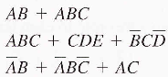
The Sum –of- Products (SOP) form
A product term consists of product of literals.
When two or more product terms are summed by Boolean addition, the resulting expression is a sum of products (SOP).
Examples
The SOP can contain a single variable term, as in A + ABC + BCD.

Slide 4
Domain of a Boolean expression
The domain of a general Boolean expression is the set of variables contained in the expression in either complemented or uncomplemented form.
Example:
The domain is A, B, C
The domain of
is A, B, C, D, E

Slide 5
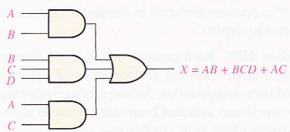
AND /OR Implementation of SOP expression
Implementing SOP expression simply requires ORing the output of two or more AND gates.
A product term is produced by an AND operation.
The sum (addition) of two or more product terms is produced by an OR operation.
example: implementing SOP expression AB + BCD + AC

Slide 6
Conversion of a general expression to SOP form
Any logic expression can be changed into SOP form by applying Boolean algebra techniques.
Example A(B + CD) can be converted to SOP form by applying the distributive law:
A(B + CD) = AB + ACD
examples

Slide 7
The Standard SOP form
A standard SOP expression is one in which all the variables in the domain appear in each product term in the expression.
For example:
Is a standard SOP expression.
Is NOT a standard SOP expression.
Standard SOP expression is important in truth tables e.t.c

Slide 8
Converting Product terms to standard SOP
Any nonstandard SOP expression (referred to simply as SOP) can be converted to the standard form using Boolean algebra.
Each product term in an SOP expression that does not contain all the variables in the domain can be expanded to standard form to include all variables in the domain and their complements.
Using rule 6 (a variable added to its complement equals 1) :

Slide 9
STEP 1. Multiply each nonstandard product term by a term made up of the sum of a missing variable and its complement.
STEP 2. Repeat step 1 until all resulting product terms contain all variables in either complemented or uncomplemented form.

Slide 10
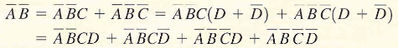
Example: Convert the following Boolean expression into standard SOP form:

Slide 11
example

Slide 12
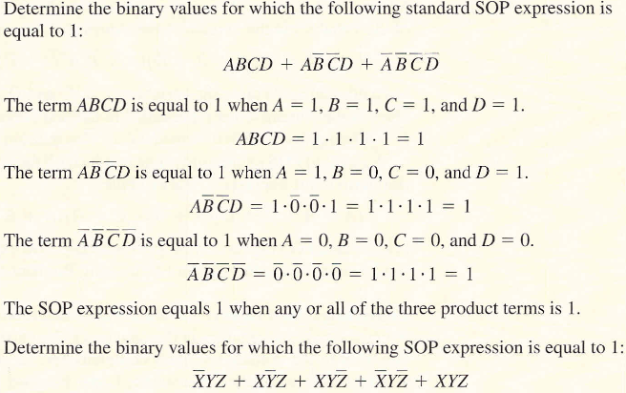
Binary representation of a Standard Product Term
SOP expression is equal to 1 only if one or more of the product terms in the expression is equal to 1.

Slide 13
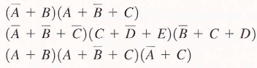
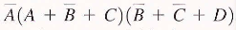
The Product-of-Sums (POS) form
When two or more sum terms are multiplied. The resulting expression is a product-of-sums (POS).
Examples:
A POS expression can contain a single-variable term, as in
A single overbar can not extend over more than one variable in a POS expression, however, more than one variable in a term can have an overbar. example
is correct is NOT correct .

Slide 14
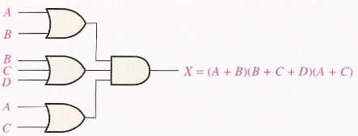
Implementing of a POS Expression
Implementing POS expression requires ANDing the outputs of two or more OR gates.
A sum term is produced by an OR operation. And the product of two or more sum terms is produced by an AND operation. Example implementing POS (A+B)(B+C+D)(A+C)

Slide 15
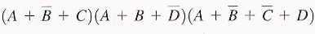
The Standard POS form
In the POS expression, some of the sum terms do not contain all of the variables in the domain of the POS expression. Example
Its domain is the variables made up of A, B, C, and D.
A standard POS expression is one in which all the variables in the domain appear in each sum term in the expression: example

Slide 16
Converting a sum term to standard POS
Any nonstandard POS expression can be converted to standard form using Boolean algebra.
Each sum term in a POS expression that does not contain all the variables in the domain can be expanded to standard form to include all the variables in the domain.
Using Boolean algebra rule 8
A nonstandard POS form can be converted to standard POS form.

Slide 17
steps
STEP 1: Add to each nonstandard product term a term made up of the product of the missing variable and its complement. This results in two sum terms. (note that you can add 0 to anything without changing its value).
STEP 2: Apply rule 12: A + BC = (A + B)(A + C)
STEP 3: Repeat step 1 until all resulting sum terms contain all variables in the domain in either complemented or uncomplemented form.

Slide 18
example
Convert the above Boolean expression into standard POS form

Slide 19
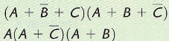
Example - convert the expressions to standard POS form
Note that a POS expression is equal to 0 only if one or more of the sum terms in the expression is equal to 0.

Slide 20
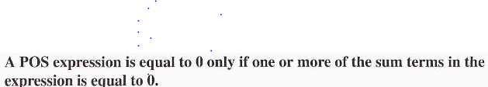
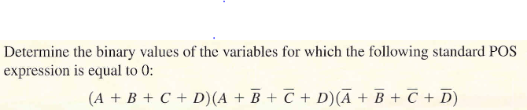
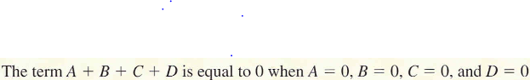
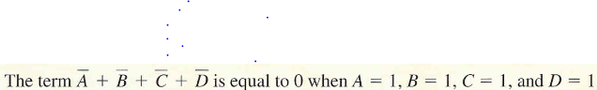
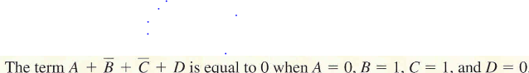

Slide 21
Converting Standard SOP to standard POS
The binary values of the product term in a given standard SOP expression are not present in the equivalent standard POS expression.
Also the binary values that are not represented in the SOP expression are present in the equivalent POS expression.

Slide 22
To convert from standard SOP to standard POS.
STEP 1. Evaluate each product term in the SOP expression. That is determine the binary numbers that represent the product terms.
STEP 2. Determine all of the binary numbers not included in the evaluation in step 1.
Step 3. Write the equivalent sum term for each binary number from STEP 2 and express in POS form.
Using the similar procedure you can go from POS to SOP

Slide 23
example
Convert the following SOP expression to an equivalent POS expression
The evaluation is as follows: 000 + 010 + 011 + 101 + 111
Since there are three variables in the domain of this expression, there are total of eight (2³) possible combinations.
The SOP expression contains five of these combinations, so the POS must contain the other three which are 001, 100, and 110
Remember, these are the binary values that make the sum term 0.
The POS is

Slide 24
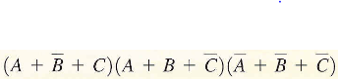
Examples: 1. Convert the following SOP expression to an equivalent POS expression
2. Convert the following POS expression to an equivalent SOP expression

Slide 25
Converting SOP expression to Truth Table format
Recall that SOP expression is equal to 1 only if at least one of the product terms is equal to 1.
A truth table is a list of the possible combinations of input variable values and the corresponding output values (1 or 0).
Construct a truth table (by listing all possible combinations of binary values of the variables in the SOP expression).
Convert the SOP expression to standard form if it is not already in standard form.
Place a 1 in the output column (X) for each binary value that makes the standard SOP expression a 1
and place a 0 for all the remaining binary values.

Slide 26
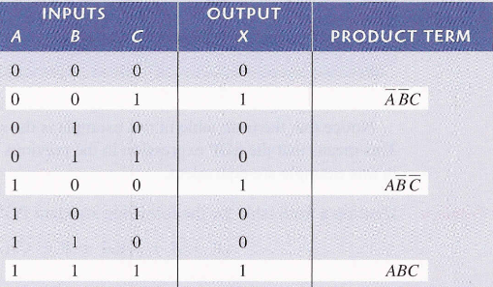
example
Develop a truth table for the standard SOP expression
Create a truth table for

Slide 27
Converting POS expression to Truth Table format
Recall that a POS expression is equal to 0 only if at least one of the sum terms is equal to 0.
Construct the truth table from the POS expression
Convert the POS expression to standard form.
Place a 0 in the output column (X) for each binary value that makes the expression a 0
And place a 1 for all the remaining binary values

Slide 28
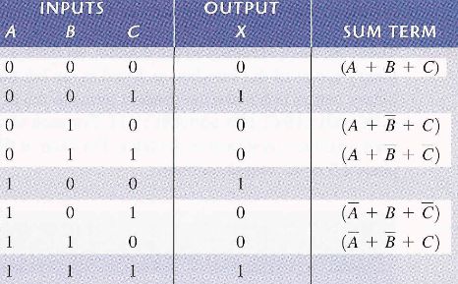
Determine the truth table for the following standard POS

Slide 29
example
Develop a truth table for the following standard POS expression

Slide 30
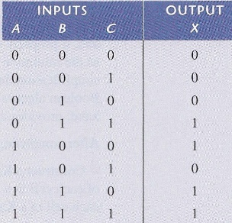
Determining standard SOP and POS from a Truth Table
Example: from truth table determine std SOP and POS

Slide 31
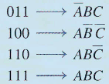
There are four 1s in the output column and the corresponding binary values are 011, 100, 110, and 111. Convert these binary values to product terms:
The resulting standard SOP expression for the output X is

Slide 32
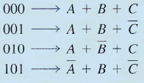
For the POS expression, the output is 0 for binary values 000, 001, 010 and 101.
Convert these binary values to sum terms as follows
The resulting POS expression for output X is

Slide 33
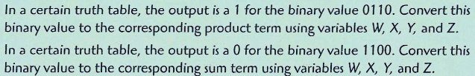
example

Slide 34
KARNAUGH MAP / METHOD
A Karnaugh map provides a systematic method for simplifying Boolean expressions and if properly used will provide the simplest SOP or POS expressions possible (known as minimum expressions).
Karnaugh map is similar to a truth table because it presents all of the possible values of input variables and the resulting output for each value.
Karnaugh map is an array of cells in which each cell represents a binary value of the input variables.

Slide 35
The 3-variable Karnaugh Map
The 3-variable Karnaugh map is an array of eight cells ( ).
In this case, A, B, and C are used for the variables although other letters could be used.
Binary values of A and B are along the left side (notice the sequence) and the values of C are at the top.
The value of a given cell is the binary values of A and B at the left in the same row combined with value of C at the top in the same column.

Slide 36
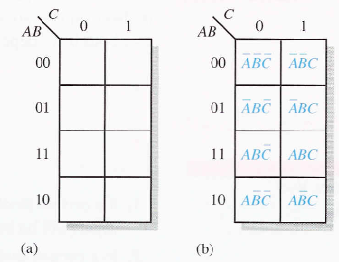
The 3-variable Karnaugh Map
In figures below: (a) shows the 3-variable Karnaugh map as array of eight cells. (which cell has value 101?)
(b) shows the standard product terms that are represented by each cell in the Karnaugh map.

Slide 37
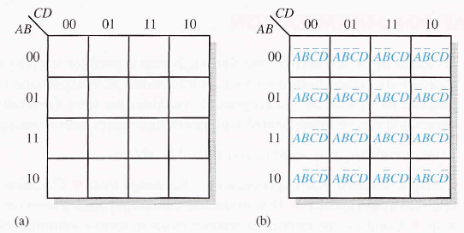
The 4-variable Karnaugh Map
The 4-variable Karnaugh map is an array of sixteen cells.
Binary values A and B are along the left side and the values of C and D are across the top.
The value of a given cell is the binary values of A and B at the left in the same row combined with the binary values of C and D at the top in the same column.

Slide 38
For example the cell in the upper right corner has a binary value of 0010 and the cell in the lower right corner has a binary value of 1010.
Figure (b) shows the standard product terms that are represented by each cell in the 4-variable Karnaugh map.

Slide 39
Cell adjacency
The cells in a Karnaugh map are arranged so that there is only a single-variable change between adjacent cells.
So ADJACENCY is defined by a single variable change.
Cells that differ by only one variable are adjacent.
Cells with values that differ by more than one variable are not adjacent.
Example in the 3-variable map the 010 cell is adjacent to the 000 cell, the 011 cell and the 110 cell.
The 010 cell is not adjacent to the 001 cell, the 111 cell, the 100 cell or the 101 cell.

Slide 40
Cell adjacency
Physically, each cell is adjacent to the cells that are immediately next to it on any of its four sides.
A cell is NOT adjacent to the cells that diagonally touch any of its corners.
Also the cells in the top row are adjacent to the corresponding cells in the bottom row.
and the cells in the outer left column are adjacent to the corresponding cells in the outer right column (“wrap-around” adjacency which form a cylinder).

Slide 41
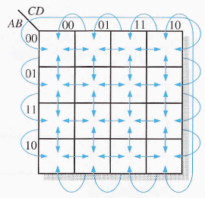
Cell adjacency
Adjacent cells in Karnaugh map are those that differ by only one variable.
Arrows point between adjacent cells.

Slide 42
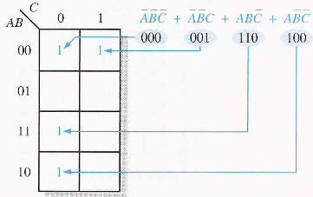
KARNAUGH MAP SOP MINIMIZATION
MAPPING A STANDARD SOP EXPRESSION:
Step 1. Determine the binary value of each product term in the standard SOP expression.
Step 2. As each product term is evaluated, place a 1 on the Karnaugh map in the cell having the same value as the product term.

Slide 43
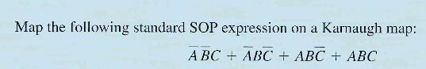
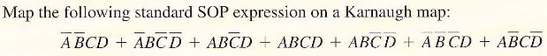

Slide 44
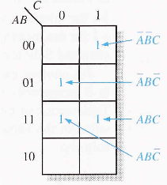
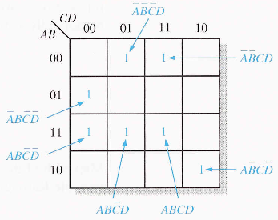
answers
Note for non standard SOP you have to convert to standard SOP.

Slide 45
Karnaugh Map simplification of SOP expressions
Minimization is the process that results in an expression containing the fewest possible terms with the fewest possible variables.
After SOP expression has been mapped, a minimum SOP expression is obtained by grouping the 1s and determining the minimum SOP expression from the map.
Enclose those adjacent cells containing 1s. The goal is to maximize the size of the groups and to minimize the number of groups.

Slide 46
rules
A group must contain either 1, 2, 4, 8 or 16 cells, which are all powers of 2. example for a 3-variable map, 2³ = 8 is the maximum group.
Each cell in a group must be adjacent to one or more cells in that sane group, but all cells in the group do not have to be adjacent to each other.
Always include the largest possible number of 1s in a group in accordance with rule 1.
Each 1 on the map must be included in at least one group. The 1s already in a group can be included in another group as long as the overlapping groups include non common 1s.

Slide 47
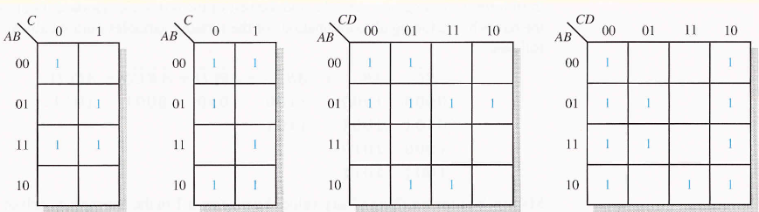
Make Karnaugh groups

Slide 48
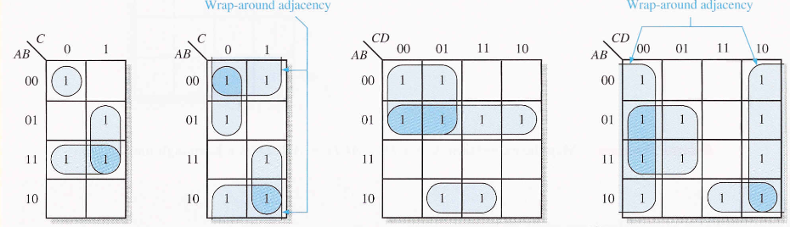

Slide 49
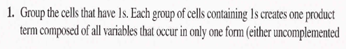
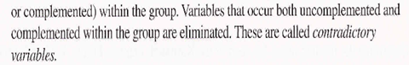
Determining the minimum SOP expression from the map
STEPS:

Slide 50
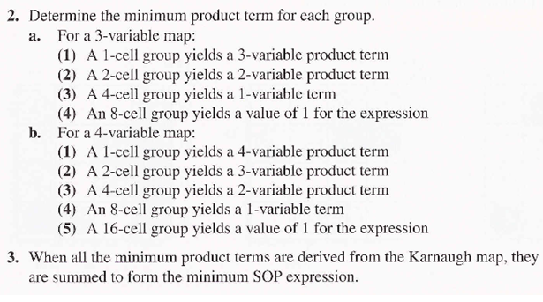

Slide 51
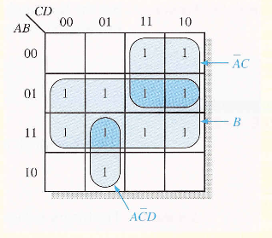
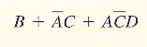
Example of determining the product term for the Karnaugh map and writing the resulting minimum SOP expression

Slide 52
Find minimum SOP

Slide 53
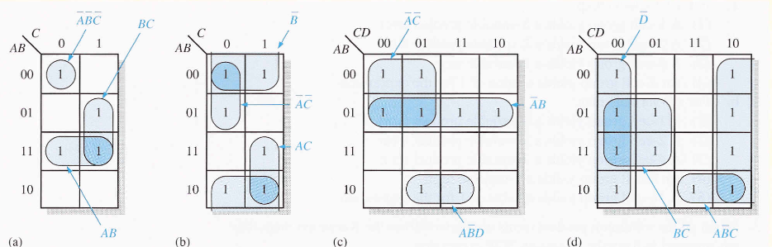
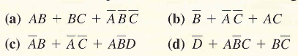

Slide 54
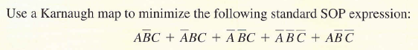

Slide 55
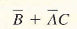
answer
Question

Slide 56
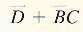
answer

Slide 57
KARNAUGH MAP POS MINIMIZATION
In mapping a standard POS expression:
STEP 1. Determine the binary value of each sum term in the standard POS expression. This is the binary value that makes the sum term equal to 0.
STEP 2. As each sum term is evaluated, place a 0 on the Karnaugh map in the corresponding cell.

Slide 58
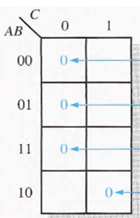
Determine the POS expression from the mapping of the Karnaugh map

Slide 59
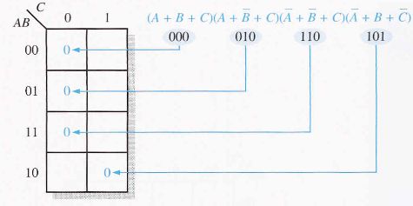

Slide 60
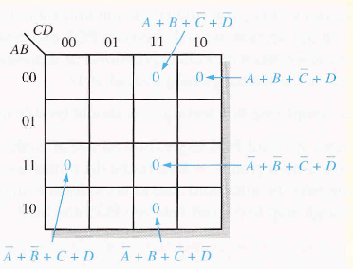
Answer
Find minimum POS

Slide 61
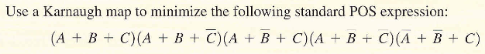
Converting between POS and SOP using Karnaugh map
For a POS expression, all the cells that do not contain 0s contain 1s, from which the SOP expression is derived.
Likewise, for SOP expression, all the cells that do not contain 1s contain 0s, from which POS expression is derived.

Slide 62
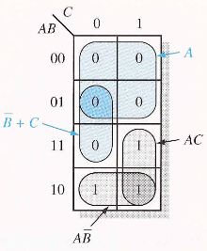
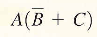
POS
Answer
For SOP
Note that

Slide 63
example

Slide 64
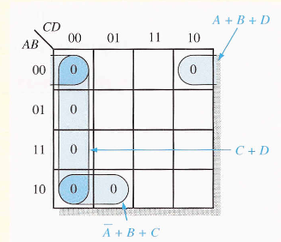
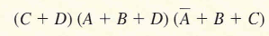
Answer for POS

Slide 65
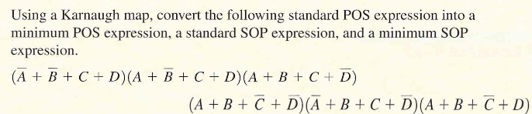

Slide 66

POS minimization using karnaugh map

Slide 67



Slide 68
DECODERS
A decoder is a digital circuit that detects the presence of a specified combination of bits (code) on its inputs and indicates the presence of that code by a specified output level.
In general a decoder has n input lines to handle n bits and from one to 2^{n} output lines to indicate the presence of one or more n-bit combinations.

Slide 69
The Basic Binary Decoder
Suppose you need to determine when a binary 1001 occurs on the inputs of a digital circuit,
An AND gate can be used as the basic decoding element because it produces a HIGH output only when all of its inputs are HIGH.
Therefore you must make sure that all of the inputs to the AND gate are HIGH when the binary number 1001 occurs.
This can be done by inverting the two middle bits (the 0s).

Slide 70

What type of gate can be used to give LOW output to indicate the presence of 1001?.
Example:

Slide 71
ENCODERS
An encoder is a combinational logic circuit that accepts an active level on one of its inputs representing a digit, such as a decimal or octal digit, and converts it to a coded output, such as BCD or binary.
Encoders can also be devised to encode various symbols and alphabetic characters. The process of converting from familiar symbols or numbers to coded format is called encoding.

Slide 72

The Decimal-to-BCD Encoder
This type of encoder has ten inputs - one for each decimal digit – and four outputs corresponding to the BCD (8421) code. This is a basic 10 - line t0 4 - line encoder.

Slide 73

Decimal to BCD code table
To analyse the logic, use the table below to determine the relationship between each BCD bit and the decimal digits.

Slide 74


Slide 75


Slide 76
MULTIPLEXER (DATA SELECTOR)
A multiplexer (MUX) is a device that allows digital information from several sources to be routed onto a single line for transmission over that line to a common destination.
So in a multiplexer, data goes from several lines to one line.
Because data can be selected from any one of the input lines, the circuit is referred to as data selector.

Slide 77

A logic symbol for 4-input multiplexer (MUX)
For a 4-input multiplexer, there are two data-select lines because with two select bits, any of the four data-input lines can be selected.

Slide 78


A 2-bit code on the data-select (S) inputs will allow the data on the selected data input to pass through to the data output.
If a binary 0 ( ) is applied to the data –data select lines, the data on input appear on the data-output line. If

Slide 79


Slide 80

The implementation of this equation requires four 3-input AND gates, a 4-input OR gate, and two inverters to generate the complements

Slide 81


Slide 82

answer

